Slide 1
Animals and Rites of Passage in Ancient Athens
CAMWS 2014
Kenneth Kitchell
kkitchell@classics.umass.edu

Slide 2
Molossian Hound

Slide 3
Hunting Hound 450-400 BC Munich Antikensammlungen: J861

Slide 4
4th- to 1st-century BC Accession number: 387
Johns Hopkins Archaeological Museum

Slide 5
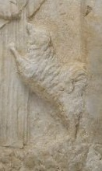
Melisto stele Harvard Museums

Slide 6
Moschion stele Getty Mid 4th

Slide 7
Chous British Museum 1864,1007.231 420BC-400BC

Slide 8
Copenhagen, National Museum, B141 Basel, Antikenmuseum und Sammlung Ludwig: BS1941.122

Slide 9
Erlangen, Friedrich-Alexander-Universitat I 321

Slide 10
Leiden, Rijksmuseum van Oudheden: I1955.1.2 500-450 BC

Slide 11
Dogs accompanying adolescent/adult activities

Slide 12
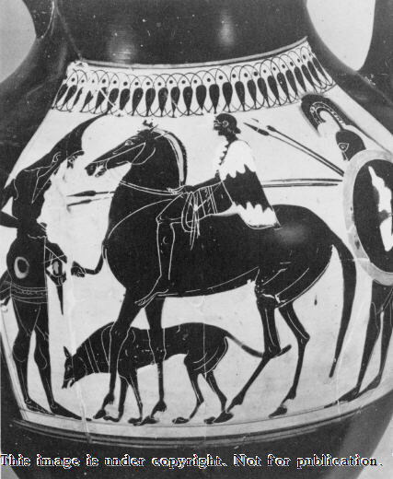

Slide 16
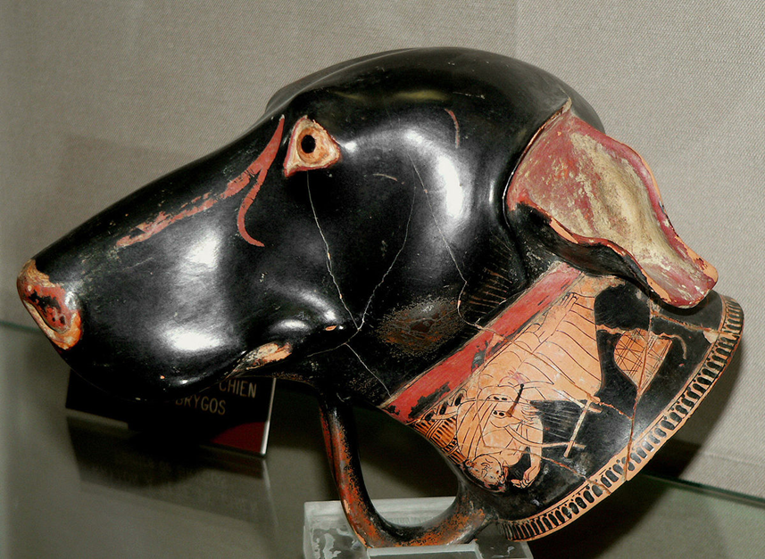
Brygos Painter 490-80 BC
Musée départemental d'archéologie Jérôme Carcopino, Aléria, Haute-Corse
Animals and Rites of Passage in Ancient Athens

Slide 18
The hunt

Slide 19
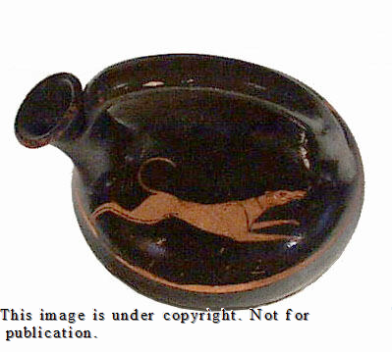
Beazley 7414 475-25 BC

Slide 20
Beazley 5756, Munich, Antikensammlungen, J861, Munich, Antikensammlungen, 2541

Slide 21
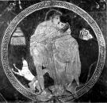
Beazley 200100 550-500
Gotha, Schlossmuseum, 48
Remove

Slide 22
Beazley 203118 Diosphos ptr 500-450 BC
Harvard Univ., Arthur M. Sackler Mus: 1925.30.51

Slide 23
Beazley 9533 575-525 BC
Munich, Antikensammlungen, J1255, Munich,

Slide 24
Kouros base Athens National Museum 510-500 BC

Slide 25
Now lost
Otto Keller Di e antike Tierwelt

Slide 26
British Museum 1772,0320.275 440-30 BC

Slide 27
Berlin Painter ca. 48o BC
British Museum 1843,1103.74

Slide 28
Moschion stele Alxenor stele

